Slide 1

Object Detection in Medical Images
IN4307- Medical Visuallization Final Project
Maria Silos Viu - 4501888
Meghna Hukeri - 4477871

Slide 2
Introduction
Identification of objects in medical images needs to be automated
Reduces the possiblity of human errors like incorrect diagnosis
Overall process speed increased significantly
Our work
Detecting femoral head in 2D X Ray Image

Slide 3
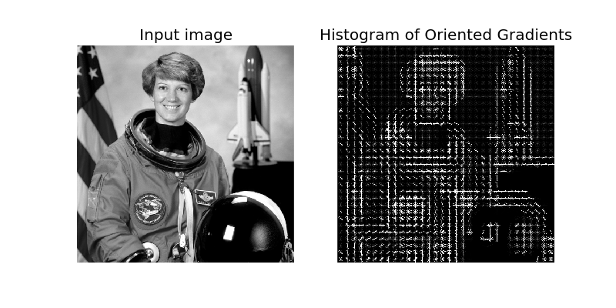
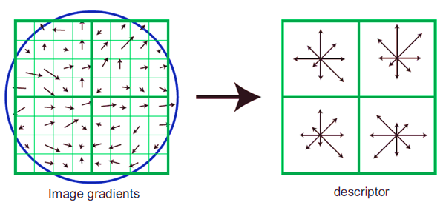
Histogram of Oriented Gradients
Image appearance → intensity gradients or edge directions.
Image divided into small regions (cells).
HOG descriptor → concatenating all histograms from each cell.
Histograms contrast normalization across ’block’
cell
block
Notes:
Object shape/appearance in image can be described as a distribution of intensity gradients or edge directions.
Image divided into small regions(cells); histograms of gradient direction for each pixel in a particular ’cell’ computed.
HOG descriptor made by concatenating all histograms from each cell.
Histograms contrast normalized across ’block’ (larger spatial region); eventually over all cells in block for better accuracy.

Slide 4
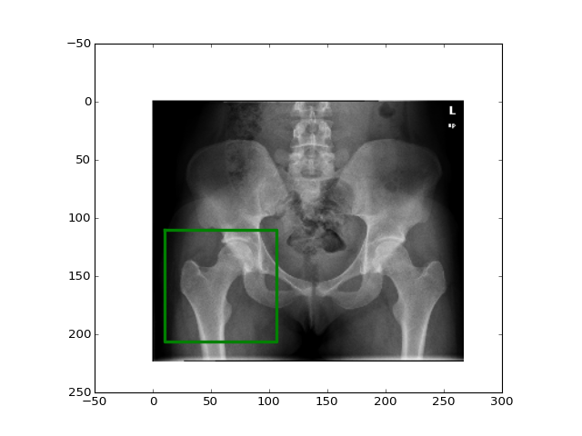
Methodology
2
DETECTION
HOG features
Classifier training
Classifier testing
3
1
P3= …
P2= …
P1= …

Slide 5
Methodology: Two approaches
Most probable patch
Non Maximum Suppresion (NMS) Method: several patches considered using a probability threshold
NMS:
Fuses the overlapping patches
Take the most probable among the non-overlapping patches

Slide 6
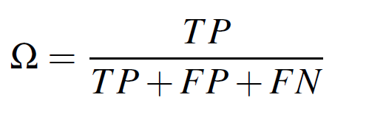

Methodology: Scoring the prediction
Measure overlap area between real and predicted patch
A: real patch
B: predicted patch
B
[Ginneken 2002]
A
$$Ω= \frac{intersection (A,B)}{union (A,B)}$$

Slide 7
Methodology
Compare both approaches with varying parameters:
NMS overlap threshold
Step size between patches
CLASSIFIERS:
K Nearest Neighbors
Support Vector Machine
Random Forest
20 classifiers

Slide 8
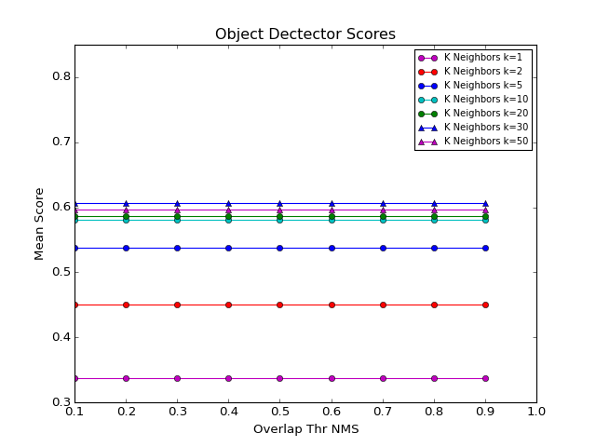
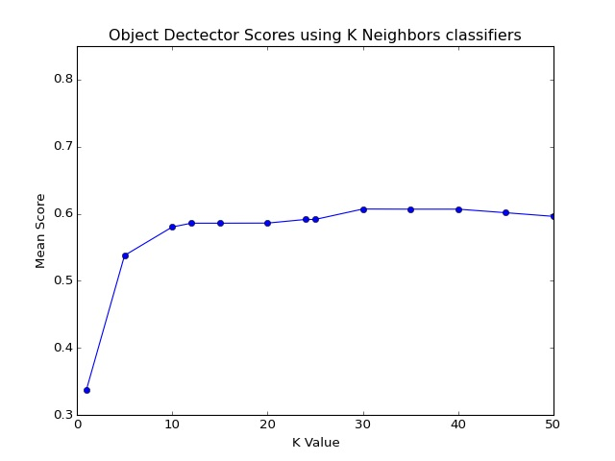
NMS overlap threshold: KNN

Slide 9
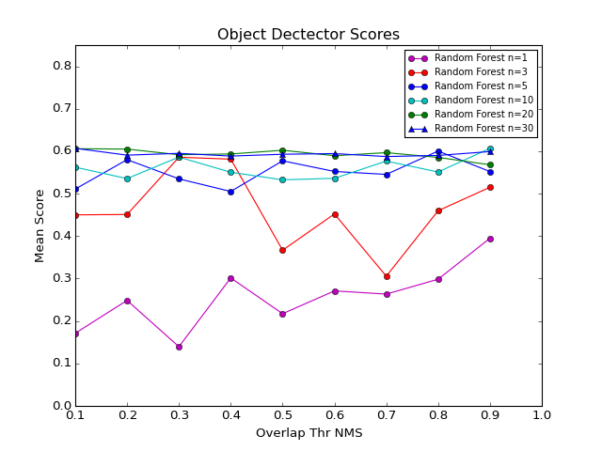
NMS overlap threshold: Random Forest

Slide 10
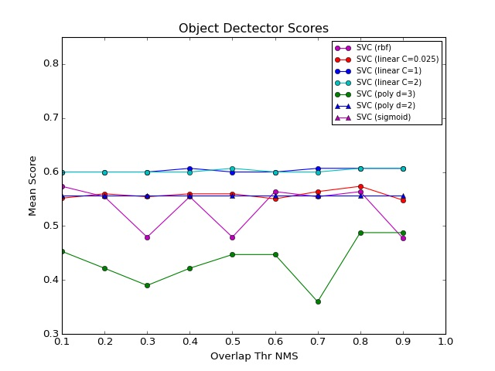
NMS overlap threshold: SVM

Slide 11
Results (I)
Varying NMS overlap threshold does not affect the score of the prediction
Scores using NMS approach were always lower or equal than the ones using the most probable patch approach
Best classifier: KNN (K=30)

Slide 12
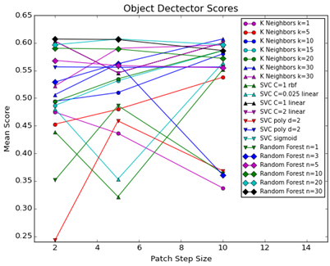
Varying Step Size

Slide 13
Results (II)
Using a lower step size between patches does not increase the score
The computational time increases a lot with decrease step size
Best step size and classifier: 10 pixels, KNN (k=30)
Scores using NMS approach were always lower or equal than the ones using the most probable patch

Slide 14
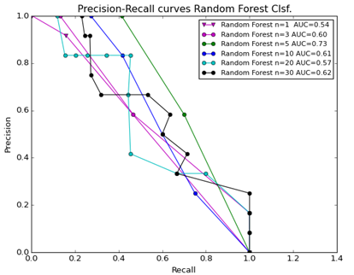
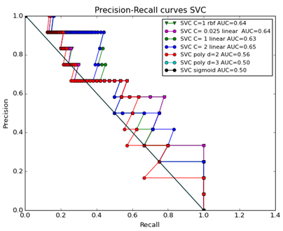
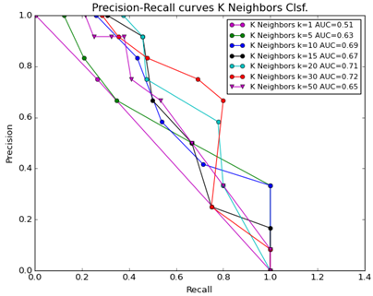
Precision Recall Curves – evaluating Classifier Performance
KNN (K=30) : AUC =0.72
RF (n=5): AUC=0.73

Slide 15
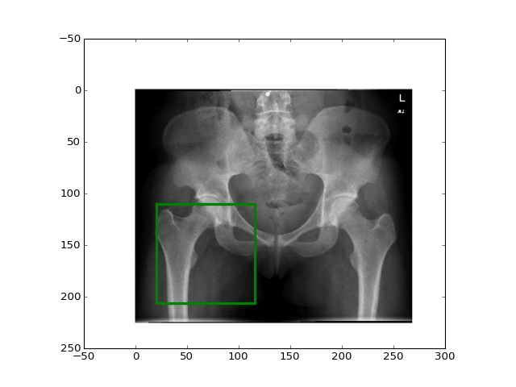
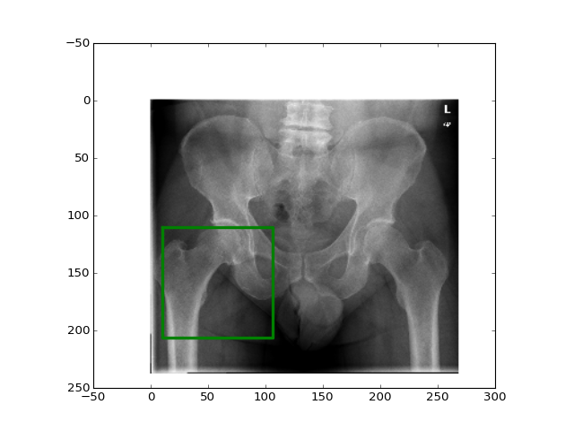
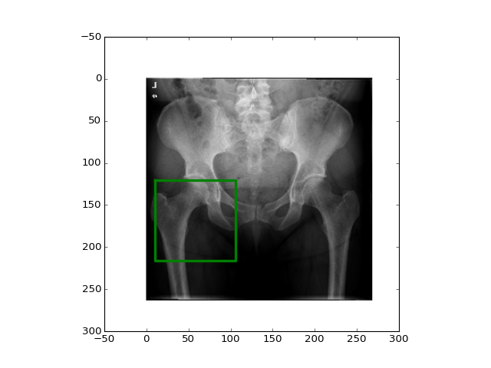
Conclussions (I): Influence of parameters
No optimal NMS overlap threshold found
Scores using NMS approach were always lower
Decreasing step size does not change prediction score but it highly increases computational cost.
Decreasing step size→ NOISE?
Scores ~60 %...

Slide 16
Conclusions (II): Classifier selection
Varying NMS overlap threshold
Best prediction by: KNN (k=30)
Varying step size
Best prediction by: Random Forest (n=30) and KNN (k=30)
step size= 2
step size= 10
Lower computational cost
Classifier performance
Random Forest (n=5): AUC=0.73 KNN (k=30): AUC=0.72

Slide 17
Conclusions (III): Summarize
Best classifier based on overall performance:
Best approach:
HOWEVER, NMS can be still very useful to other applications in medical object detection…
KNN (k=30)
Most probable patch approach

Slide 18
THANK YOU FOR YOUR ATTENTION

